Slide 1
VA Home & Community Based Services
Andrea L. Hubalek, LICSW
Marykate Monroe, LCSW
113 Holland Ave
Albany, NY 12208

Slide 2
WHO WE ARE
Veterans Benefits Administration
Veterans Health Administration
National Cemetery

Slide 3
Veterans Benefits Administration
Includes the following:
Pension
Survivors’ benefits
Fiduciary
Compensation
Education
Vocational Rehabilitation & Employment
Life Insurance
Home Loan Guaranty
For Benefits Information:
1-800-827-1000
http://www.benefits.va.gov
U.S. Department of Veterans Affairs Homepage:
https://www.va.gov/
NYS Division of Veterans’ Services:
https://www.veterans.ny.gov/

Slide 4
Veterans Service Officers
There is no comparable advocacy service for this special group of New York citizens.
All services are provided without charge.
Strictly controlled confidentiality
Service Officers are required to be knowledgeable in federal, state and local laws pertaining to Veterans.
VA education and vocational rehabilitation
VA home loan guaranties
VA, State & Local employment and reemployment
Military records
Federal, State & Local medals or awards
Local real property tax exemption
NYS blind annuity
VA compensation for service-connected disabilities
VA pension for non-service-connected disabilities
VA compensation/pension to family members of deceased veterans
VA burial benefits and grave markers
VA life insurance
https://www.va.gov/ogc/apps/accreditation/index.asp

Slide 5
Aide and Attendance Part 1
Am I eligible for Veterans Pension benefits?
You may be eligible for the Veterans Pension program if you meet these requirements.
Both of these must be true:
You didn’t receive a dishonorable discharge,
and
Your yearly family income and net worth meet certain limits set by Congress. Your net worth includes all personal property you own (except your house, your car, and most home furnishings), minus any debt you owe. Your net worth includes the net worth of your spouse.
From December 1, 2022, to November 30, 2023, the net worth limit to be eligible for Veterans Pension benefits is $150,538

Slide 6
Aide and Attendance Part 1
And at least one of these must be true about your service:
You started on active duty before September 8, 1980, and you served at least 90 days on active duty with at least 1 day during wartime,
or
You started on active duty as an enlisted person after September 7, 1980, and served at least 24 months or the full period for which you were called or ordered to active duty (with some exceptions) with at least 1 day during wartime,
or
You were an officer and started on active duty after October 16, 1981, and you hadn’t previously served on active duty for at least 24 months
And at least one of these must be true:
You’re at least 65 years old,
or
You have a permanent and total disability,
or
You’re a patient in a nursing home for long-term care because of a disability,
or
You’re getting Social Security Disability Insurance or Supplemental Security Income

Slide 7
Aide and Attendance Part 2
At least one of these must be true:
You need another person to help you perform daily activities, like bathing, feeding, and dressing, or
You have to stay in bed—or spend a large portion of the day in bed—because of illness, or
You are a patient in a nursing home due to the loss of mental or physical abilities related to a disability, or
Your eyesight is limited (even with glasses or contact lenses you have only 5/200 or less in both eyes; or concentric contraction of the visual field to 5 degrees or less)
Housebound benefits eligibility
You may be eligible for this benefit if you get a VA pension and you spend most of your time in your home because of a permanent disability (a disability that doesn’t go away).
Note: You can’t get Aid and Attendance benefits and Housebound benefits at the same time

Slide 8
PACT ACT
The PACT Act is a new law that expands VA health care and benefits for Veterans exposed to burn pits and other toxic substances. This law helps us provide generations of Veterans—and their survivors—with the care and benefits they’ve earned and deserve.
The Act (1) expands and extends eligibility for VA health care for Veterans with toxic exposures and Veterans of the Vietnam era, Gulf War era, and Post-9/11 era, and
(2) expands eligibility for benefits for Veterans exposed to toxic substances.
Learn more and sign up at VA.gov/PACT
Download the VA Health and Benefits App
Call us at 1-800-MyVA411 (1-800-698-2411)
Find a VA at VA.gov/find-locations/

Slide 9
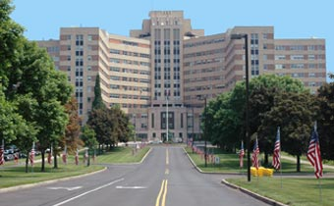
Veteran Healthcare & Stratton VA Medical Center
Primary Care
Emergency Department
10 Bed ICU
15 Bed Inpatient Psychiatry Unit
2 Medical/Surgical 25-Bed Inpatient Units
CDRP- 12 Bed SAARTP (6 week program) IOP and Outpatient
Women’s Wellness Center
Outpatient and Specialty Clinics
50 Bed Community Living Center

Slide 10
Health Care Eligibility
How to become a patient at the Albany VA or Community Clinic https://www.albany.va.gov/patients/eligibility.asp
Online Application https://www.vets.gov/health-care/apply/
Application Form https://www.va.gov/vaforms/medical/pdf/1010EZ-fillable.pdf
Our local Veterans Service Center is located at 113 Holland Ave in Albany, NY (across from AMC) on the 1st floor.
518-626-6745

Slide 11
Income Requirements
2023 VA National and Priority Group 8 Relaxation Income Thresholds
Income Thresholds for Cost-Free Health Care, Medications and/or Beneficiary Travel Eligibility
Based on Income Year 2022
Veteran With: | VA National Income Threshold | VA Priority Group 8 Relaxation Threshold | VA Housebound Threshold | VA Aid and Attendance Threshold | VA Pension Threshold | Medical Expense Threshold
0 dependents | $36,659 | $43,834 | $19,598 | $26,752 | $16,037 | $738
1 dependent | $43,990 | $52,600 | $24,562 | $31,714 | $21,001 | $966
2 dependents | $46,513 | $55,617 | $27,305 | $34,457 | $23,744 | $1,103
3 dependents | $49,036 | $58,634 | $30,048 | $37,200 | $26,487 | $1,240
4 dependents | $51,559 | $61,652 | $32,791 | $39,943 | $29,230 | $1,377
For each additional dependent add: | $2,743 | $2,743 | $2,743 | $2,743 | $2,743 | 5% of maximum allowable pension rate from the previous year

Slide 12
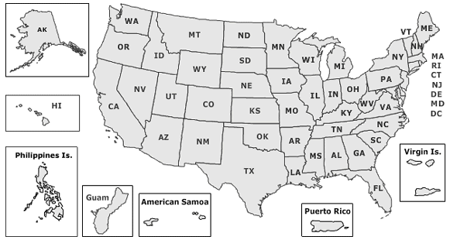
Stratton VA Medical Center and CBOCs
Stratton VAMC in Albany
Community Based Outpatient Clinics (CBOCs)
Catskill
Clifton Park
Fonda
Glens Falls
Kingston
Oneonta
Plattsburgh
Saranac Lake
Schenectady

Slide 13
Specialty Care
Albany VA provides a wide range of medical and surgical specialty care services including:
Anesthesiology
Allergy
Amputee Clinic
Audiology
Bariatric surgery
Cardiology – Vascular
Chaplaincy
Critical Care Specialty
Dermatology
Diabetes and Endocrinology
Dialysis
EMG EEG
ENT
Gastroenterology
Geriatrics & Palliative Care
Gynecology Care
Infectious Disease
Nephrology
Neurology
Hematology/Oncology
Occupational Therapy
Optometry & Ophthalmology, Low Vision
Orthopedic Surgery
Orthotic and Prosthetic (Amputee Care & Custom Orthotics)
Pacemaker
Pain Management
Podiatry
Pulmonary
Radiation Therapy
Radiology
Rheumatology
Robotic-Assisted Surgery
Spinal Cord Injury
Sleep Medicine
Speech Pathology
Transplant Surgery (Heart, Lung, Liver, etc.)
Urology
Vascular Surgery
Wound Care

Slide 14
Albany Stratton VAMC Women’s Health
Women Veterans Health Care- Albany VAMC
Women only Primary Care clinic – 8D Women’s Wellness Center
Full time Gynecologist on-site
Maternity Care is covered through Community Care
Includes prenatal care, delivery of baby and up to six weeks postpartum. Visits with local OB or Certified Nurse Midwife.
Newborn Coverage for 7 days following birth
Call 518-626-5911 or 518-626-5968 to schedule an appointment
Women Veterans Call Center: 1-855-829-6636
Women’s Health Program Manager: Emily DiSalvo 518-626-5519

Slide 15
Comprehensive Mental Health Care
Walk In Clinic (Rapid Access Clinic)
Outpatient
(Individual/Group, VJO, IPV, MST, PTSD, Family Therapy, etc)
Inpatient Mental Health Unit
Behavioral Health Recovery Center
Substance Abuse Rehab
Healthcare for Homeless Veterans
Vocational

Slide 16
Comprehensive MEDICAL Health Care
Preventive Care
Immunizations, Annual exams, Vision and Hearing exams, Screening tests, Health Education Programs, etc.)
Inpatient & Outpatient Diagnostic & Treatment Services
Prescriptions
Prosthetics and Rehabilitative Devices
Dental (limited)

Slide 17
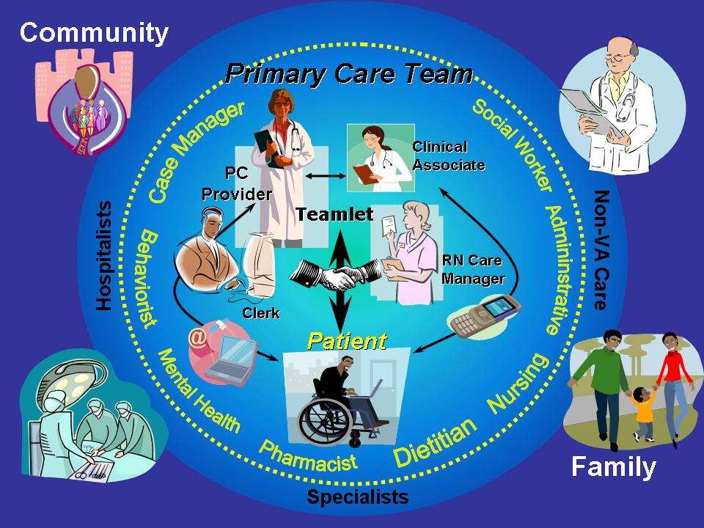
Patient Aligned Care Team (PACT) Model
16

Slide 18
New Era of Services
My Healthy Vet
Apps
Secure Messaging
Telehealth, Telemedicine, Telepsychiatry
Social Networking
Family Services
Computerized Patient Record System
Caregiver Line (1-855-260-3274)
Crisis Line (1-800-273-8255 and Press 1)

Slide 19
Medical Social Work
Support team members with challenging patient-care situations
Eliminate barriers to health care interventions
Build upon and promote strengths and abilities
Educate and motivate Veteran toward health promotion, disease prevention and management of self
Offer strategies to resolve underlying causal factors
Follow Veteran through continuum of health care
Eliminate barriers to care
Reach out to high risk cohorts
Assess underlying causal factors leading to presenting concern
Using short-term and long-term interventions in treatment plans
Monitor high risk discharges to avoid readmission

Slide 20
Geriatric Services
Homemaker/Home Health Aid Program
Veteran Directed Home & Community
Home-Based Primary Care
Geriatric Primary Care
Palliative Care
Contracted Adult Day Program
Caregiver Support

Slide 21
Homemaker/Home Health Aide Program
Clinical eligibility
Focus of program is to assist Veterans with management of Activities of Daily Living (ADLs).
ADLs include: bathing, toileting, grooming, dressing, eating, transferring, and ambulation.
IADLs – Instrumental Activities of Daily Living – medication management, financial management, grocery shopping, meal preparation, using a telephone and housework
Need for the program is evaluated on an ongoing basis and it is recommended that Veteran maintains an annual Primary Care visit with VA provider.
VA contracts/has agreements with Licensed Home Care Agencies in the community in order to offer the H/HHA services to Veterans.

Slide 22
Veteran Directed Home and Community Based Services
It is a self-directed program to support aging in place and to enable the Veteran avoid institutionalization.
Clinically complex Veterans are initially qualified. Or if a homecare agency is not secured in 90 days through the VA HHA program
Veterans enrolled in VDHCBS manage their own flexible budgets and decide for themselves what mix of goods and services best meet their needs, as well as hire and supervise their own workers.
The Aging Network provides facilitated assessment and care/service planning, arranges fiscal management services, and provides ongoing options counseling and support to Veterans.
You may also find additional information by following the link below.
https://www.acl.gov/programs/veteran-directed-home-and-community-based-services/veteran-directed-home-community-based
ONLY AVAILABLE IN THE FOLLOWING COUNTIES:
Albany, Rensselaer, Saratoga, Columbia, Otsego and Greene

Slide 23
Home Based Primary Care
Provides primary care services to Veterans in their home environment
Designed to meet the needs of Veterans who have difficulty leaving their home because of illness to access primary care services either at the Albany VA or one of the Community Based Outpatient Clinics
Team of health care professionals (Medical provider, Nursing, Social Work, Psychology, Dietician, and Physical/Occupational Therapist)
Coverage area is approx. 50 miles from Albany VAMC with recent rural expansion.

Slide 24
Contracted Adult Day Health Care
Goal is to maintain or improve the health of patients by focusing on both their social and health needs
Enables caregivers to continue caring for their loved one at home
Care is provided in a safe, structured setting
Veterans may attend program daily or a few times a week depending on their needs
Plattsburgh CCN
Hearthstone in Catskill
Washington Center
Guildcare in Latham
*Transportation is not covered or provided by the VA
*List is subject to change- please consult VA for updates

Slide 25
VA Funded Institutional Care: Community Living Center (CLC) and Contract Nursing Home
VA provides nursing home care to any Veteran in need of such care and who meets the following criteria:
Indication for NH care is directly related to a Service Connected (SC) disability (determined by VA physician) or
Rated 60% SC and Unemployable or
Combined SC disability at 70% or higher
AND
Clinical Eligibility:
PRI – assessment tool to determine level of care. It looks at Veteran’s overall functioning and level of care needed to meet the needs.
VA institutional hospice care for end-of-life is available to all Veterans (no matter the service connection) who meet clinical eligibility criteria for hospice and require nursing home level of care.

Slide 26
VA Funded Institutional Care: Community Living Center (CLC) and Contract Nursing Home
VA contracts with community nursing homes in order to provide care in the Veteran’s community if so desired.
Currently we have 14 contracts with community facilities
Monthly oversight around care provided to the Veterans
Review of facilities’ State Surveys and ratings
CNH Office can be reached at 626-6087
Community Living Center or CLC is the Albany Stratton VA Medical Center’s nursing home:
Unit located on the 9th floor of the medical center
Currently long term care only

Slide 27
VA End of Life Benefit
All Veterans are eligible for this benefit regardless of service connection
MUST
*Be enrolled in the VA healthcare system
*Meet skilled nursing home level of care
*Hospice eligibility
- Only VA contracted facilities

Slide 28
Caregiver Support Program
Comprehensive Assistance for Family Caregivers (PCAFC)
Sustained or aggravated a serious injury (or illness) in the line of duty in the active military, naval or air service during any service era. Among other applicable eligibility criteria, an eligible Veteran must:
Have a single or combined service-connected disability rating by the Department of Veterans Affairs (VA) of 70% or more, and
Be in need of personal care services (requiring in-person personal care services) for a minimum of six continuous months based on any one of the following:
- An inability to perform an activity of daily living. - A need for supervision or protection based on symptoms or residuals of neurological or other impairment or injury; or - A need for regular or extensive instruction or supervision without which the ability of the Veteran to function in daily life, would be seriously impaired.
VA Caregiver Support Program Home

Slide 29
Summary
Remember the VA is here to help!
Communicate early and often!
Thank you for serving those who served!

Slide 30
Questions?
Comments?
Feedback?
www.va.gov
Andrea.Hubalek@va.gov
Marykate.Monroe@va.gov

